Slide 1

Domain: MATLAB
Technology: Communication
<AUTOCORRELATION BASED SPECTRUM SENSING OF FBMC SIGNAL
<Name of the Students>

Slide 2
Index:
Abstract
Introduction
Literature review
Existing Method
Drawbacks
Proposed method
Advantages
Hardware and Software Requirements
Results
Conclusion
References

Slide 3
Abstract :
The focus of this paper is on a feature detector for filter bank multicarrier (FBMC) signal in cognitive radio. In this paper, we first prove that the FBMC signal samples are uncorrelated with each other. However, if the FBMC signal is processed by our proposed method, then the autocorrelation function (ACF) of FBMC signal becomes non-zero at the lag equal to number of subcarriers. On the other hand, additive white Gaussian noise (AWGN) samples after the same proposed processing remain uncorrelated. Using this feature, an autocorrelation based feature detector is proposed to detect FBMC signal in noise. The main advantage of the proposed detector is that, unlike blind detectors, this detector can distinguish between FBMC signal and noise (or interference). Next, the distribution of the test statistic of the proposed detector is derived under noise-only scenario so that the threshold of the Neyman-Pearson detector can be designed to maintain constant false alarm rate while maximizing the probability of detection. Simulation results demonstrate the efficacy of the proposed detector.

Slide 4
Introduction:
Orthogonal Frequency Division Multiplexing (OFDM) has been a dominant technology in 4G LTE-Advanced.
However, OFDM might be a misfit for future generation cellular technologies such as 5G and cognitive radios due to some disadvantages such as loss in spectral efficiency due to cyclic prefix (CP) insertion, high out-of-band radiation and sensitivity to narrowband interferers.
As shown in main outcomes of EU research projects 5GNOW and PHYDYAS, filter bank multicarrier (FBMC) is a promising alternative to OFDM for 5G and cognitive radios, respectively.
FBMC uses well designed bank of filters with minimum out-of-band radiation and no use of CP means significant improvement in the spectral efficiency.

Slide 5
Introduction:
Spectrum sensing is one of the most important tasks in cognitive radios.
In the traditional cognitive radio standards, the main problem has been to detect the presence of primary (licensed or legacy) user using incumbent geolocation databases and spectrum sensing techniques.
However, the challenging problem of heterogeneous secondary coexistence has garnered very less attention in the cognitive radio standards and related literature.
Since 5G will involve multitier heterogeneous networks in heterogeneous bands (licensed as well as unlicensed), acquiring spectrum awareness regarding the secondary users is equally important

Slide 6
Literature review:
S. No | Journal Type With Year | Authors | Title | Outcomes
1 | vol. 52, no. 2, pp. 97–105, February 2014. | G. Wunder, P. Jung, M. Kasparick, T. Wild, F. Schaich et al | 5GNOW: non-orthogonal, asynchronous waveforms for future mobile application | Some fundamental indications about wireless communications beyond LTE/LTE-A (5G)
2 | vol. 19, no. 4, pp. 41–48, Aug. 2012 | B. Gao, J.-M. Park, Y. Yang, and S. Roy | A taxonomy of coexistence mechanisms for heterogeneous cognitive radio networks operating in TV white spaces | To offer a clear picture of the heterogeneous coexistence issues and related technical challenges
3 | vol. 2, no. 1, pp. 4–17, 2008 | R. Tandra and A. Sahai | SNR Walls for Signal Detection | Signal detection methods

Slide 7
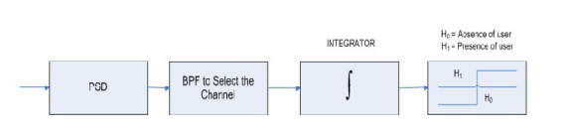
Existing method:
Energy detection:
Although blind detection techniques such as energy detection, can be used to detect any waveform, they cannot distinguish between noise and interfering signal. If no enough information is available about the primary user signal, which is usually the case in a CR environment, energy detection can be used. This can be done simply by band-pass filtering the required bandwidth, then squaring and integrating the output over the observation interval, and then the result is compared with a certain threshold to decide whether a primary user is present or not .
Figure: Existing Block Diagram

Slide 8
Disadvantages in Existing method:
Noise and ACI affect the performance of the energy detector, a very poor performance at low SNR was observed.
The energy detector cannot differentiate signal types but can only determine the presence of the signal. Thus, the energy detector cannot differentiate between primary and secondary user signals. This makes it prone to false alarm when another secondary user attempts to access the same channel.

Slide 9
Proposed method:
FBMC is a multicarrier transmission technique that is an attractive alternative to the OFDM technique.
In OFDM, FFT acts like a filter using rectangular window in time domain which amounts to frequency response at each subcarrier (or sub channel) being a sinc function.
The sinc function has high side-lobes resulting in out-of-band ripples. In FBMC, in order to reduce the out-of-band ripples, the main-lobe of filter-frequency-response at each subcarrier is spreaded while side-lobes are reduced so that only adjacent subchannels are overlapping
The even (or odd) indexed subchannels are separated and there is overlap between adjacent subcarriers

Slide 10
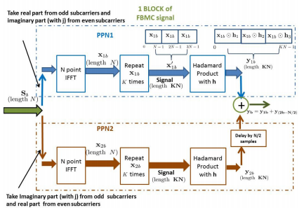
Proposed method:
FBMC block diagram

Slide 11
Proposed method:
In OQAM technique, the real and imaginary parts of a complex symbol are delayed by half the symbol time and are not transmitted simultaneously, thus making the subcarriers orthogonal.
The delay of half the symbol time introduced here reduces the capacity of the system.
Hence, to achieve full capacity the symbol rate is doubled and two poly-phase networks (PPNs) are employed for low-complexity implementation of OQAM-FBMC so that the size of IFFT block reduces from KN to N.
As the focus of this paper is not to explain the efficient OQAM-FBMC implementation using PPNs, we direct interested readers to for discussion on actual efficient implementations of OQAM-FBMC using PPNs

Slide 12
Advantages of Proposed method:
A Proposed autocorrelation detector which is the proposed method can distinguish between FBMC-plus-noise and noise-only scenarios.
Proposed autocorrelation detector has good performance when compared to existing method.

Slide 13
Applications:
1.Spectrumsensing
2. Resource allocation and scheduling.
3.Powersystem line outage detection
4.Bioinformatics
5. Quality control

Slide 14
Hardware and Software Requirements:
Software: Matlab 2018a or above
Hardware:
Operating Systems:
• Windows 10
• Windows 7 Service Pack 1
• Windows Server 2019
• Windows Server 2016
RAM:
Minimum: 4 GB
Recommended: 8 GB

Slide 15
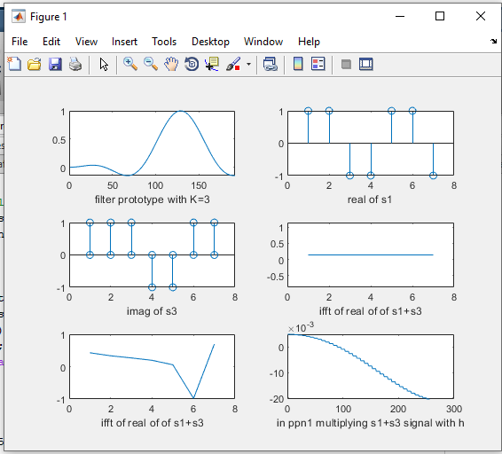
RESULTS

Slide 16
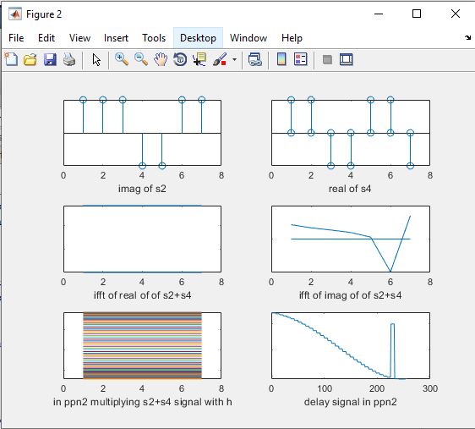
RESULTS

Slide 17
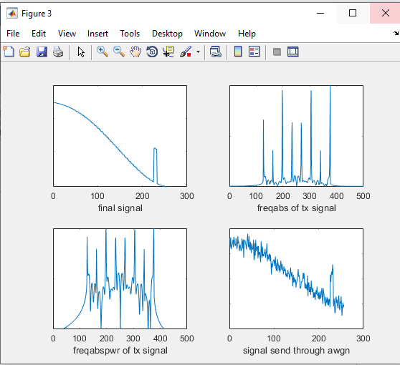
RESULTS

Slide 18
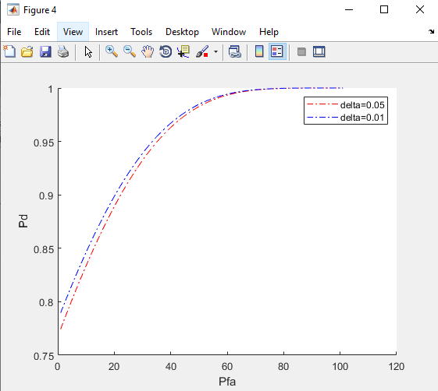
RESULTS
Fig.: Receiver operating characteristic (ROC) curves

Slide 19
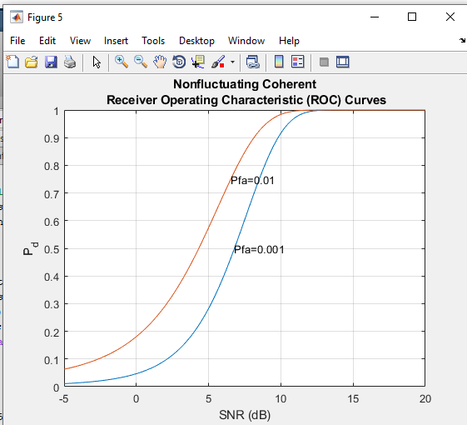
RESULTS
Fig. : PD Vs SNR [dB] plot for FBMC signal for PFA =0.01 and pfa=0.001

Slide 20
CONCLUSION:
We have demonstrated that FBMC signal does not have any autocorrelation property. However, after suitably modifying the received signal, the autocorrelation property is clearly visible. This property is used to differentiate between noise-only and FBMC-plus-noise scenarios. A detector is proposed and distribution of test statistic under the noise only scenario is derived so that the threshold for the Neyman- Pearson detector can be designed. It is demonstrated that the proposed autocorrelation detector has good performance. Further research would be carried out to analyze the performance of the detector under unknown noise variance scenario.

Slide 21
References:
G. Wunder, P. Jung, M. Kasparick, T. Wild, F. Schaich et al., “5GNOW: non-orthogonal, asynchronous waveforms for future mobile applications,” IEEE Communications Magazine, vol. 52, no. 2, pp. 97–105, February 2014.
B. Farhang-Boroujeny, “Filter bank multicarrier modulation: A waveform candidate for 5G and beyond,” Advances in Electrical Engineering, 2014.
——, “OFDM versus filter bank multicarrier,” IEEE signal processing magazine, vol. 28, no. 3, pp. 92–112, 2011.
PHYDAS, “Physical layer for dynamic spectrum access and cognitive radio,” Online, 2010, (Accessed: Apr. 2016). [Online]. Available: http://www.ict-phydyas.org

